Slide 1
Jewish Identity In Max Steiner’s Symphony of Six Million
Aaron Fruchtman
California State University, Long Beach
Max Steiner: Man and Myth
February 24-25, 2018

Slide 2
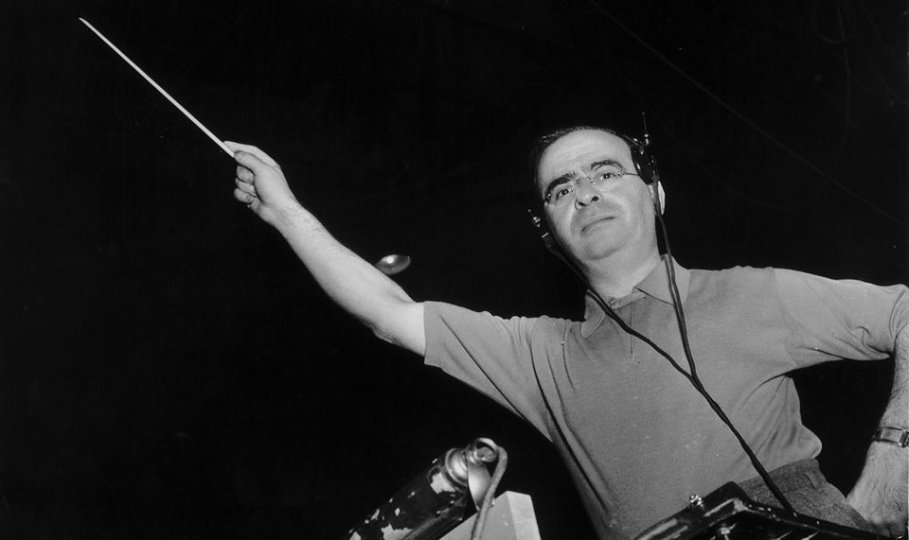
Max Steiner (1888-1971)

Slide 4
Steiner Philanthropy (1939-1952)
Charity | Year | Amount Donated (in $)
Red Cross | 1945 | 350
LA War Chest | 1945 | 1000
Red Cross Infantile Paralysis | 1946 | 1000
Red Cross Infantile Paralysis | 1948 | 1000
Red Cross Infantile Paralysis | 1949 | 1000
Red Cross Infantile Paralysis | 1950 | 1000
Cedars of Lebanon Hospital | 1951 | 250
Cedars of Lebanon Hospital | 1952 | 250
Charity | Year | Amount Donated (in $)
United Jewish Welfare Fund | 1939 | 1500
 | 1940 | 1000
 | 1941 | 1500
 | 1944 | 1050
 | 1945 | 1000
 | 1946 | 1500
 | 1947 | 1500
 | 1948 | 1500
 | 1949 | 2000
 | 1950 | 2000
 | 1951 | 2000
 | 1952 | 2000

Slide 5
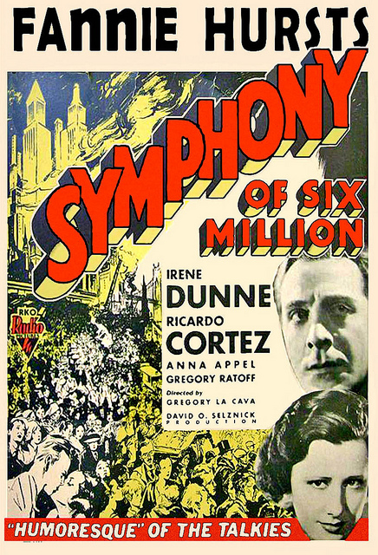

Slide 6
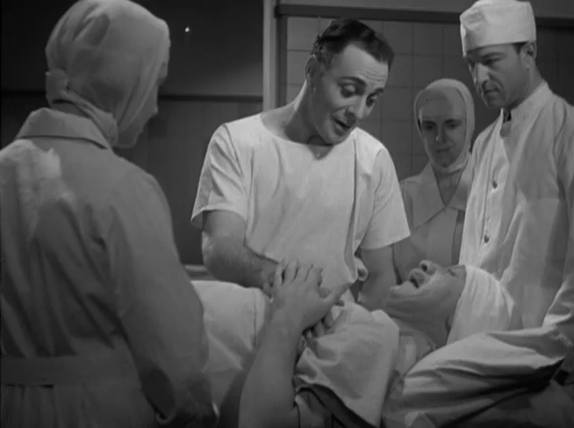
Symphony of Six Million (1932)

Slide 7
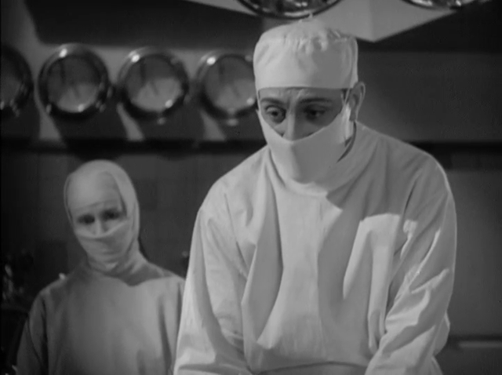
Symphony of Six Million (1932)

Slide 9
“Oyfn Pripetshik”
Oyfn pripetchik brent a fayerl, un in shtub is heys. Un der rebe lernt kleyne kinderlekh Dem alef-beyz.
Refrain: Zet zhe kinderlekh, Gedenkt zhe, tayere, vos ir lernt do, Zogt zhe nokh a mol un take nokh a mol: "Komets-alef: o!"
Lernt, kinder, mit groys kheyshek, Azoy zog ikh aykh on, Ver s'vet gikher fun aykh kenen ivre, Der bakumt a fon.
Az ir vet, kiderlech, elter vern, vet ir aleyn farshteyn, vie'fl in die oysiyos liegn trern un vie fiel geveyn.
Az ir vet, kinder, dem goles shlepn, Oysgemutshet zayn, Zolt ir fun di oysyes koyekh shepn, Kukt in zey arayn!
At the fireplace a little fire burns And in the room it's warm, And the Rabbi teaches little children The aleph-bet.
Refrain: See you affectionately children-dear, Remember dear (ones), what you're learning here Say once again, and then once again, "Komets-alef: o!"
Learn, children, with great desire, Thus say I to you, Whomever amongst you most quickly learns Hebrew, he shall receive an award!
When you will, children-dear, older become, You yourselves will understand How many tears in the letters lie, And how much weeping.
When you will, children-dear, bear the exile, (and) wrought-out be, You should from the letters draw strength, Look in them inside!

Slide 11
Jewish Identity In Max Steiner’s Symphony of Six Million
Aaron Fruchtman
California State University, Long Beach
Max Steiner: Man and Myth
February 24-25, 2018

