Slide 1


An Austrian in Hollywood: Leitmotifs, Key Relationships, and Self‐Plagiarism in Max Steiner’s Music for Now, Voyager and Mildred Pierce
Max Steiner: Man and Myth
A Symposium
February 24-25, 2018
The Anatol Center at California State University, Long Beach
Charles Francis Leinberger, Ph.D.
The University of Texas at El Paso
CHARLESL@UTEP.EDU

Slide 2
An Austrian in Hollywood: Leitmotifs, Key Relationships, and Self‐Plagiarism in Max Steiner’s Music for Now, Voyager and Mildred Pierce
Max Steiner: Man and Myth
A Symposium
February 24-25, 2018
The Anatol Center at California State University, Long Beach
Charles Francis Leinberger, Ph.D.
The University of Texas at El Paso
CHARLESL@UTEP.EDU

Slide 3
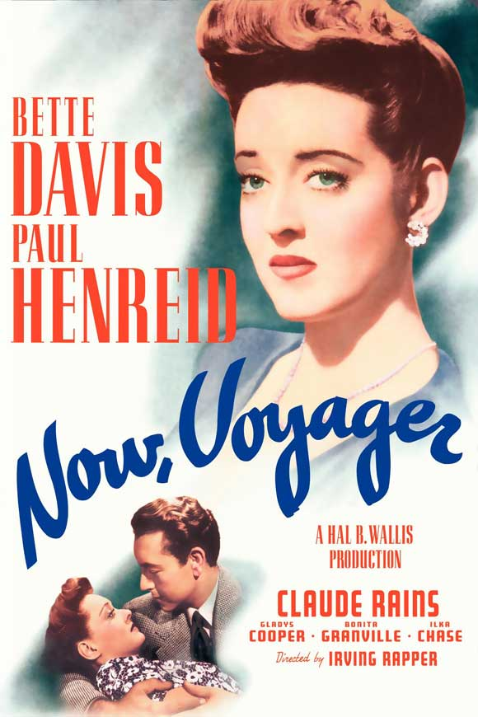
Now, Voyager (1942)
Directed by Irving Rapper
Starring
Bette Davis
Paul Henreid
Claude Rains
Gladys Cooper
Music by Max Steiner

Slide 4
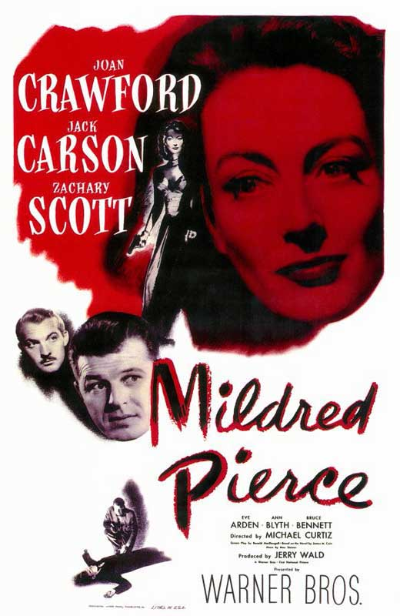
Mildred Pierce (1945)
Directed by Michael Curtiz
Starring
Joan Crawford
Jack Carson
Zachary Scott
Eve Arden
Ann Blyth
Music by Max Steiner

Slide 5
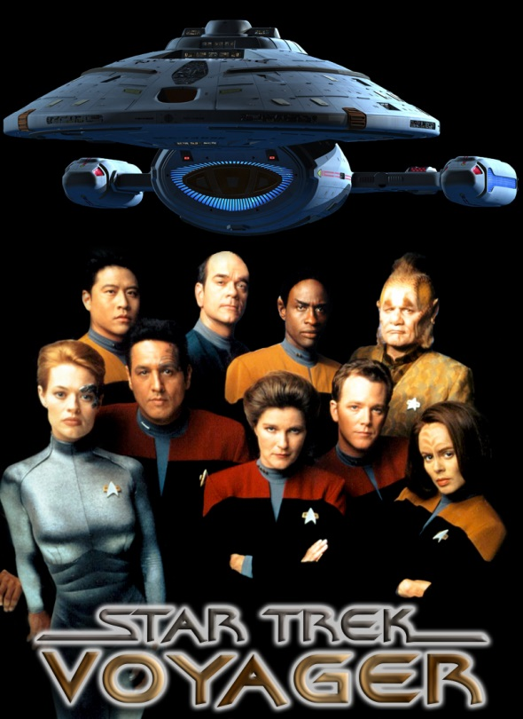
Star Trek: Voyager, “The Killing Game” (1998)
Directed by David Livingston
Starring
Kate Mulgrew
Robert Beltran
Jeri Ryan
Robert Picardo
Main Title Music by Jerry Goldsmith
“It Can’t Be Wrong”
Music by Max Steiner
Lyrics by Kim Gannon
Sung by Jeri Ryan
Notes:
IMDB.com credits Dick Haymes as “Written by” on “It Can’t Be Wrong.”

Slide 6
Acknowledgements
Kate Daubney, Series Editor, Scarecrow Film Score Guides
Steve Haddad, Lecturer, The University of Texas at El Paso
Edward Murphy, Professor, Dissertation Director, The University of Arizona
The Warner Bros. Archive, School of Cinema-Television, The University of Southern California, Los Angeles, California
The Max Steiner Collection, Arts and Communications Archive, Brigham Young University, Provo, Utah
Notes:
IMDB.com credits Dick Haymes as “Written by” on “It Can’t Be Wrong.”

Slide 7
Bibliography
Daubney, Kate. Max Steiner’s Now, Voyager: A Film Score Guide. Westport, Connecticut: Greenwood Press, 2001.
Gorbman, Claudia. Unheard Melodies. Bloomington & Indianapolis: Indiana University Press, 1987.
Leinberger, Charles Francis. An Austrian in Hollywood: Leitmotifs, Thematic Transformation, & Key Relationships in Max Steiner’s 1942 Film Score, Now, Voyager. Dissertation. The University of Arizona, 1996.
Steiner, Max. Notes to You: An Unpublished Autobiography. 1963-64.
Steiner, Max. Now, Voyager. Orch. Hugo Friedhofer. ms. 763. University of Southern California, Los Angeles. 1942.

Slide 8
Questions and Comments?
CHARLESL@UTEP.EDU

